Slide 1

Chapter 5
Analog Transmission
5.<number>
Copyright © The McGraw-Hill Companies, Inc. Permission required for reproduction or display.

Slide 2
5-1 DIGITAL-TO-ANALOG CONVERSION
Digital-to-analog conversion is the process of changing one of the characteristics of an analog signal based on the information in digital data.
Topics discussed in this section:
Aspects of Digital-to-Analog Conversion
Amplitude Shift Keying
Frequency Shift Keying
Phase Shift Keying
Quadrature Amplitude Modulation
5.<number>

Slide 3

Figure 5.1 Digital-to-analog conversion
5.<number>

Slide 4

Figure 5.2 Types of digital-to-analog conversion
5.<number>

Slide 5

Note
Bit rate is the number of bits per second. Baud rate is the number of signal
elements per second.
In the analog transmission of digital data, the baud rate is less than
or equal to the bit rate.
5.<number>

Slide 6
Example 5.1
An analog signal carries 4 bits per signal element. If 1000 signal elements are sent per second, find the bit rate.
Solution
In this case, r = 4, S = 1000, and N is unknown. We can find the value of N from

Slide 7
Carrier Signal
In analog transmission, the sending device produces a high frequency signal that acts as a basis for the informational signal. This base signal is called the carrier signal or carrier frequency.
Digital information then modulates the carrier signal by modifying one or more of its characteristics. This kind of modification is called modulation (or shift keying).
5.<number>

Slide 8
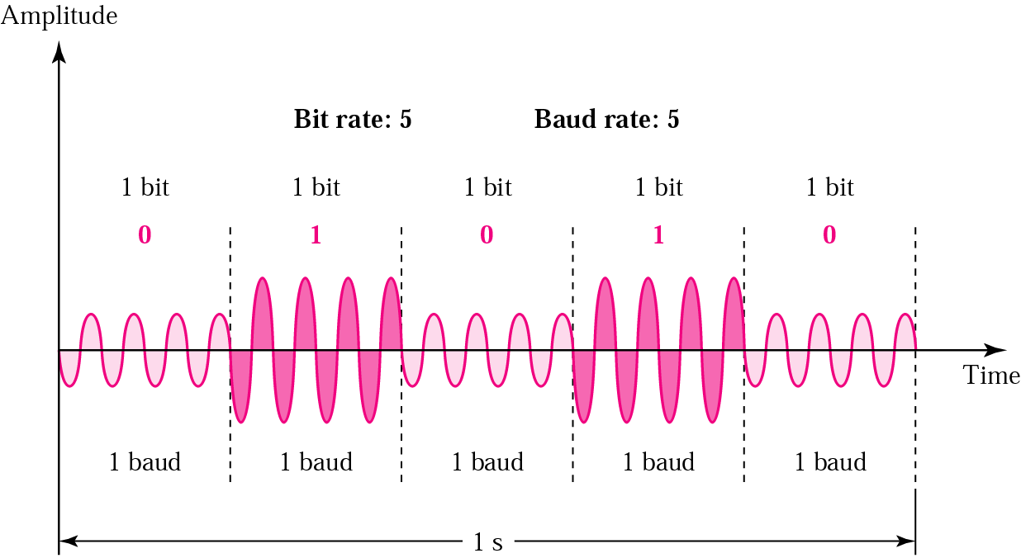
Amplitude shift keying
Values represented by different amplitudes of carrier
5.<number>

Slide 9

Figure 5.3 Binary amplitude shift keying
5.<number>

Slide 10

Figure 5.6 Binary frequency shift keying
5.<number>

Slide 11

Figure 5.9 Binary phase shift keying
5.<number>

Slide 12
Note
Quadrature amplitude modulation is a combination of ASK and PSK.
5.<number>

Slide 13
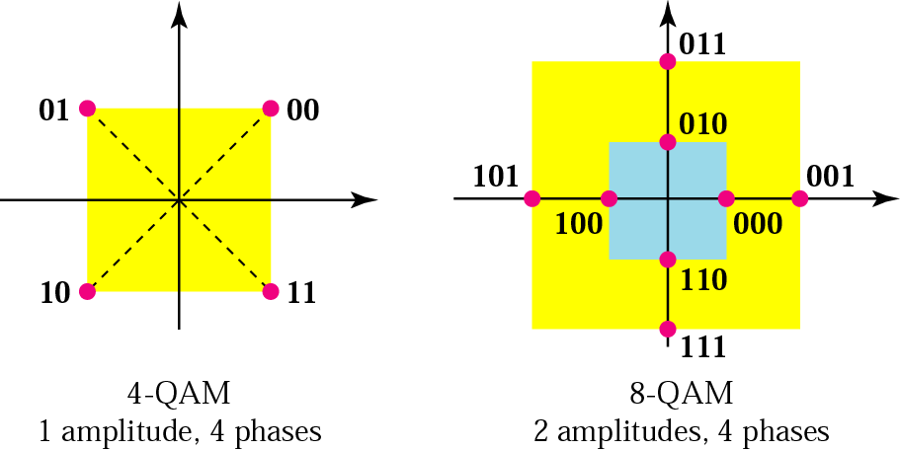
Quadrature Amplitude Modulation
Quadrature amplitude modulation is a combination of ASK and PSK so that a maximum contrast between each signal unit (bit, dibit, tribit, and so on) is achieved.
5.<number>

Slide 14
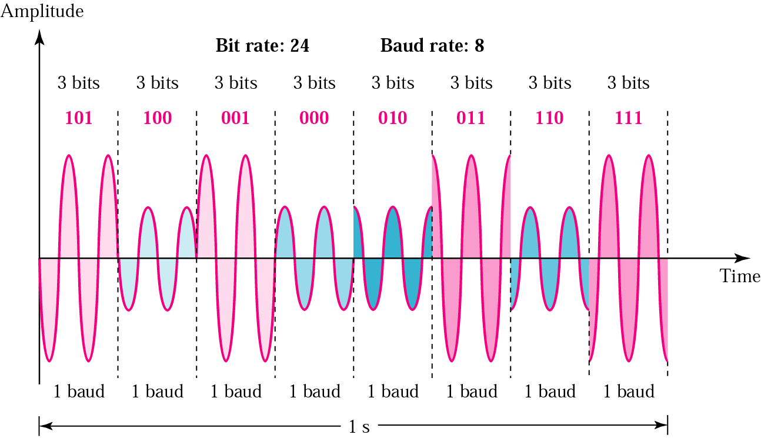
Time domain for an 8-QAM signal
5.<number>

Slide 15
5-2 ANALOG AND DIGITAL
Analog-to-analog conversion is the representation of analog information by an analog signal. One may ask why we need to modulate an analog signal; it is already analog. Modulation is needed if the medium is bandpass in nature or if only a bandpass channel is available to us.
Topics discussed in this section:
Amplitude Modulation
Frequency Modulation
Phase Modulation
5.<number>

Slide 16

Figure 5.15 Types of analog-to-analog modulation
5.<number>

Slide 17

Figure 5.16 Amplitude modulation
5.<number>

Slide 18

Figure 5.18 Frequency modulation
5.<number>

Slide 19
Phase Modulation
It only differs from FM as,
In FM the instantaneous change in the carrier frequency is proportional to the amplitude of the modulating signal.
In PM the instantaneous change in the carrier frequency is proportional to the derivative of the amplitude of the modulating signal.
5.<number>

Slide 20

Figure 5.20 Phase modulation
5.<number>

